Slide 1
House Pricing Analysis
Ibrahim Hafiz

Slide 2
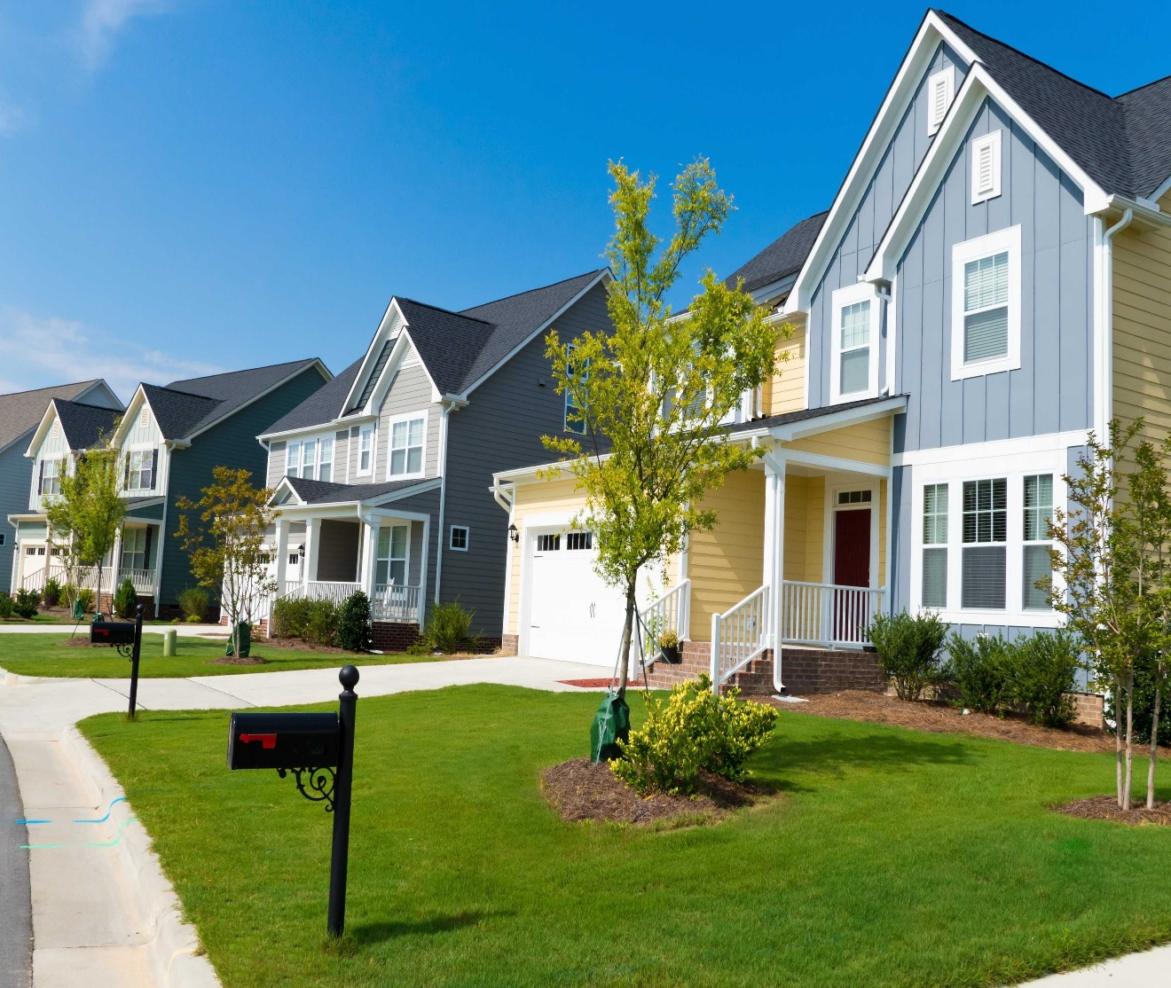
Table of content
- Business Understanding
- Data Understanding & Methods
- Data Preparation
- Results
- Assumption checks
- Accuracy
- Conclusion

Slide 3

Business Understanding
Our stakeholder is a real estate company that is looking to expand its market to King County. They need to be provided with a reliable prediction model about how new home renovations might increase the estimated value of homes in the area, and by what amount.

Slide 4

Data Understanding and Methods Used
- We have obtained house data from King County to help us build the model. This includes useful information like the price of the property, the living area in square feet and the year the property was renovated to name a few.
- There are some data which is not really relevant to our model which we can remove.

Slide 5
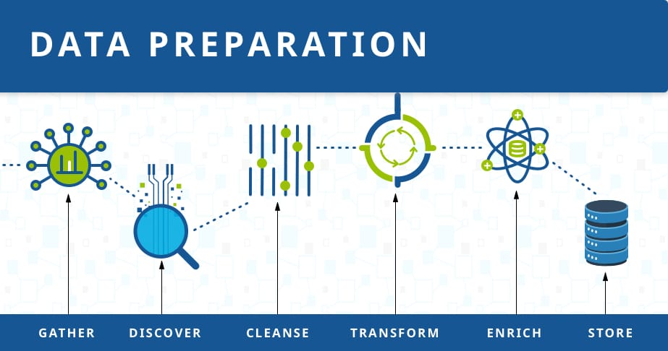
Data preparation
We will start by removing the rows with the null values because we do not know whether they have been renovated or not. We will also remove the basement values which are not numbers.
We will drop the house with 33 bedrooms because it is the only outlier we will do this when cleaning the data.
This will allow us to have plenty of data to use after removing them. Finally we will remove the outliers in the bedroom as well.

Slide 6
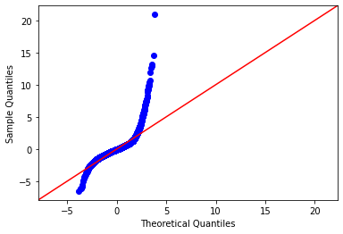
Results in Model 1 and Model 2
From our analysis we can seen that the sample quantites and theoretical quantities are not related. We need to build another model to get a better analysis on the price of the houses at King county.
- std_above had p-values had a high value which we will remove in our next model.

Slide 7
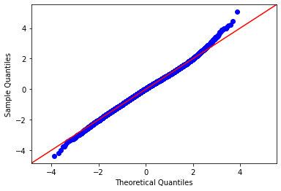
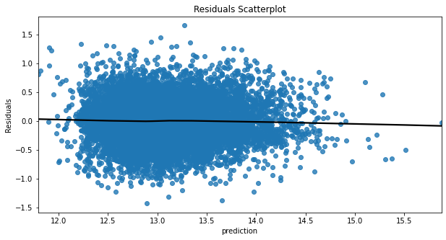
Model 3
- Our model has improved which shows us that the sample quantities and Theoretical quantities are related, This will give us a clear picture on the house pricing in the area and factors that will affect the pricing the area.
- We also checked for Homoscedasticity, this will help us know that the error is constant along the values of our dependent variable. This will give us a better understanding of our data.

Slide 8
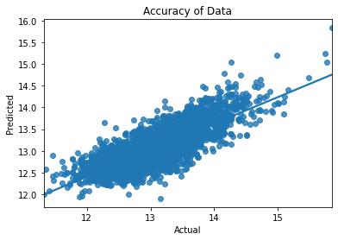
Accuracy of the Model
- Accuracy of the model is
61.6%
- There is a good relationship
between the actual results and
our predicted results.
-With training and testing being
similar we can expect the model to
perform similarly.

Slide 9

Conclusion
- The Living area has strongest relationship with prices because people spend time inside the house and having a large living area generally means that more rooms, making it more appealing to potential buyers.
-This will give our stakeholder a grasp of the type of houses available at King County and the specification of what makes the value of a house appeciate in value or sell for.

Slide 10

Question and Answer
- We would be welcome to answer any questions or concerns on our presentation.

